Slide 1
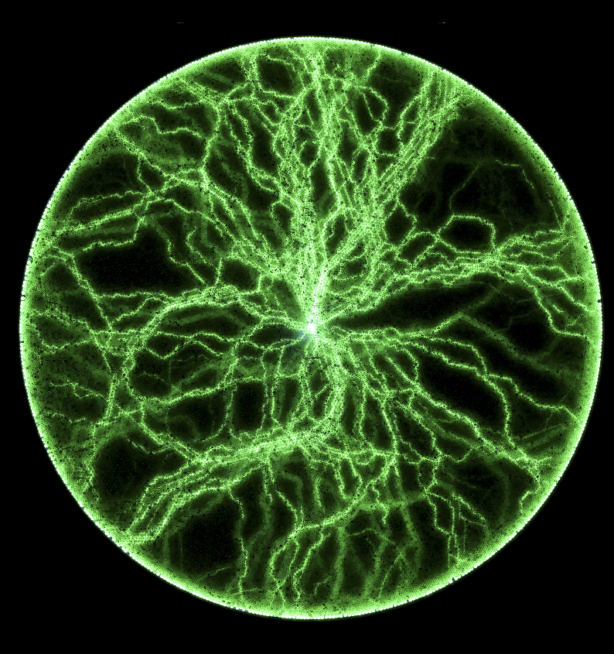
Headline Verdana Bold
AI Batch J Group 1
Presented on 10/18/2021

Slide 2
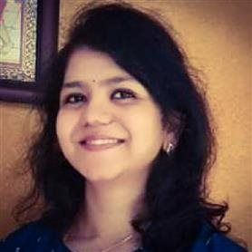
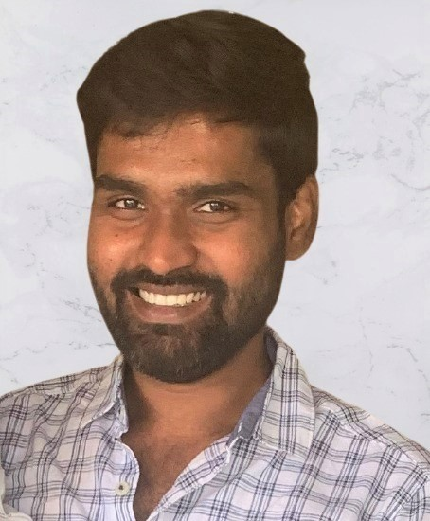
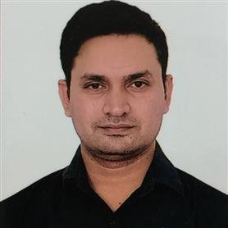
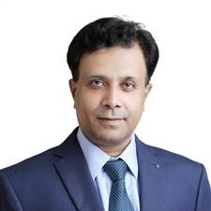
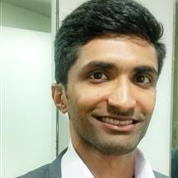
DNAV Architects
Yata Bhavani
Ashok Thotakura
Kumar, Pradip
Venkata Rama Krishna
Sunny, Clint

Slide 3
ER Diagram

